Slide 1
Notes
Payments Portal
Update and Preference
Examples provided are wireframes only. Final design and phrasing to be determined.
Each experience will have variations for desktop, mobile, and tablet. Specific experiences shown depict the desktop customer experience to illustrate user flows only.
Preference experiences have undergone 2 CXBRs in 2013 and a high fidelity user study in December 2013. Both experiences have been recently reviewed by Eva Manolis.
Daniel J. Callicoat 06/05/14

Slide 2
Table of contents
Section 1: Update
  4 - “I lost my credit card.“
Section 2: Preference
  15 - “I want to save my choices.“
  29 - “I want to see what choices will be used.“
  33 - “I want to easily select a different preference.“
Appendix:
  41 - Preference UI for mobile
  43 - Update UI for mobile
  45 - Consolidated subscriptions page
  47 - High fidelity preference display
  49 - Deferred update
  55 - Eligibility conflicts during update
  61 - Eligibility conflicts during purchase
  63 - “I got a failure email.”
  72 - “I want to change my primary card.”
  80 - Multi-tender preferences

Slide 3
Section 1: Update
Common customer problems:
  • “I lost my credit card. But when I deleted it, all of my subscriptions, memberships, and open orders failed without Amazon warning me.”
  • “I got a failure email. I fixed the order but then I got another email for a different order. And then another one.”
  • “I want to use my new Amazon.com Visa as my primary credit card but there’s no way to change it across the entire site. I have to update each location my previous card is used in.”

Slide 4


I lost my credit card
I lost my credit card.
“I lost my card. I immediately went to Amazon, deleted it, and added a new card. But my subscriptions began failing anyway. Why do I have to go to so many places to make a change?”

Slide 5
“I lost my credit card.”
Why this is broken today:
Feature teams (e.g. Prime, Subscribe & Save, E-periodicals) store their preferences locally. When a card is deleted, payments platform has no visibility into these preferences.
Customers must go to different pages within Amazon to update orders, preferences, and subscriptions.
How Payments Portal will fix this:
Create a shared preference service. When a customer deletes a card, show them where it is used and allow them to fix any broken associations.
New customer experience:
1) Delete credit card in wallet
2) Fix broken associations

Slide 6
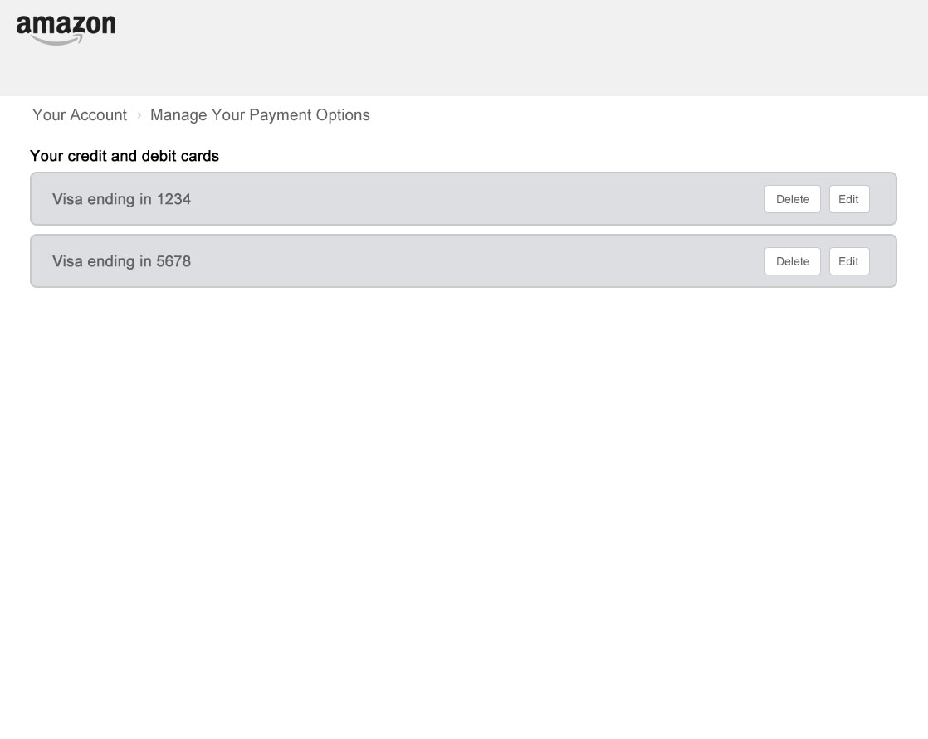

User navigates to the Payment Options page and chooses to delete the chosen card.

Slide 7
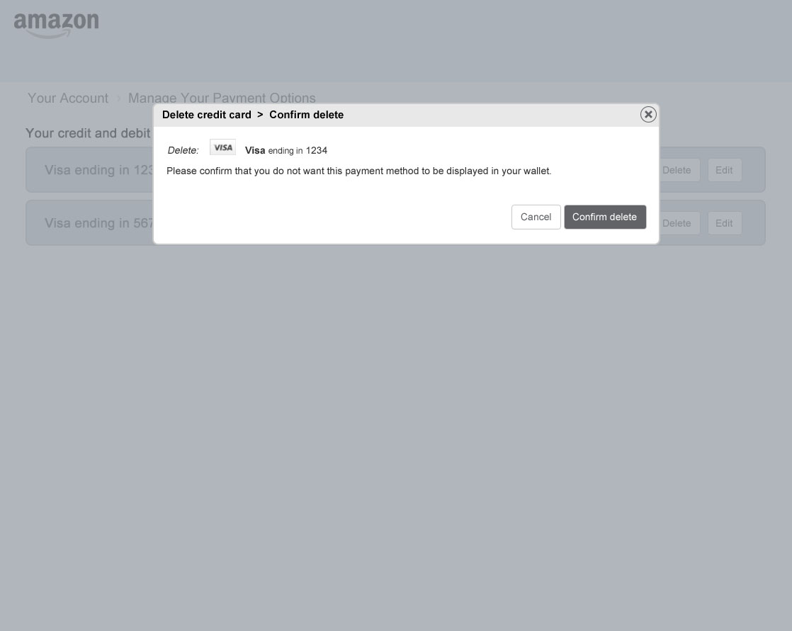
The user then confirms the card deletion.

Slide 8
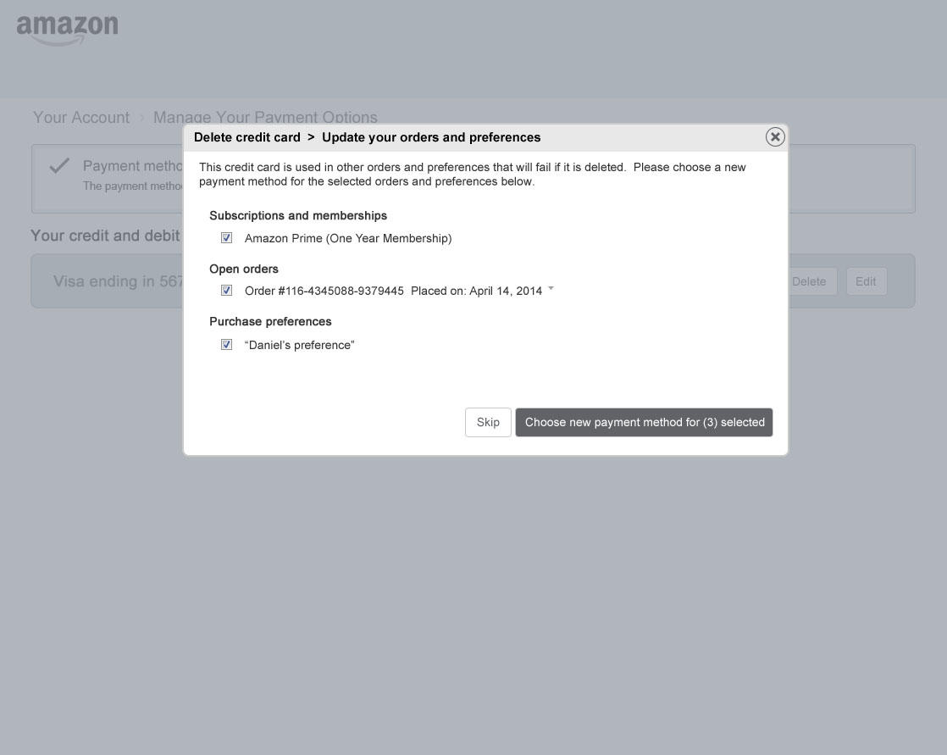
If the card is used in other places, the associations are shown and the user is allowed to choose
a new payment method.

Slide 9
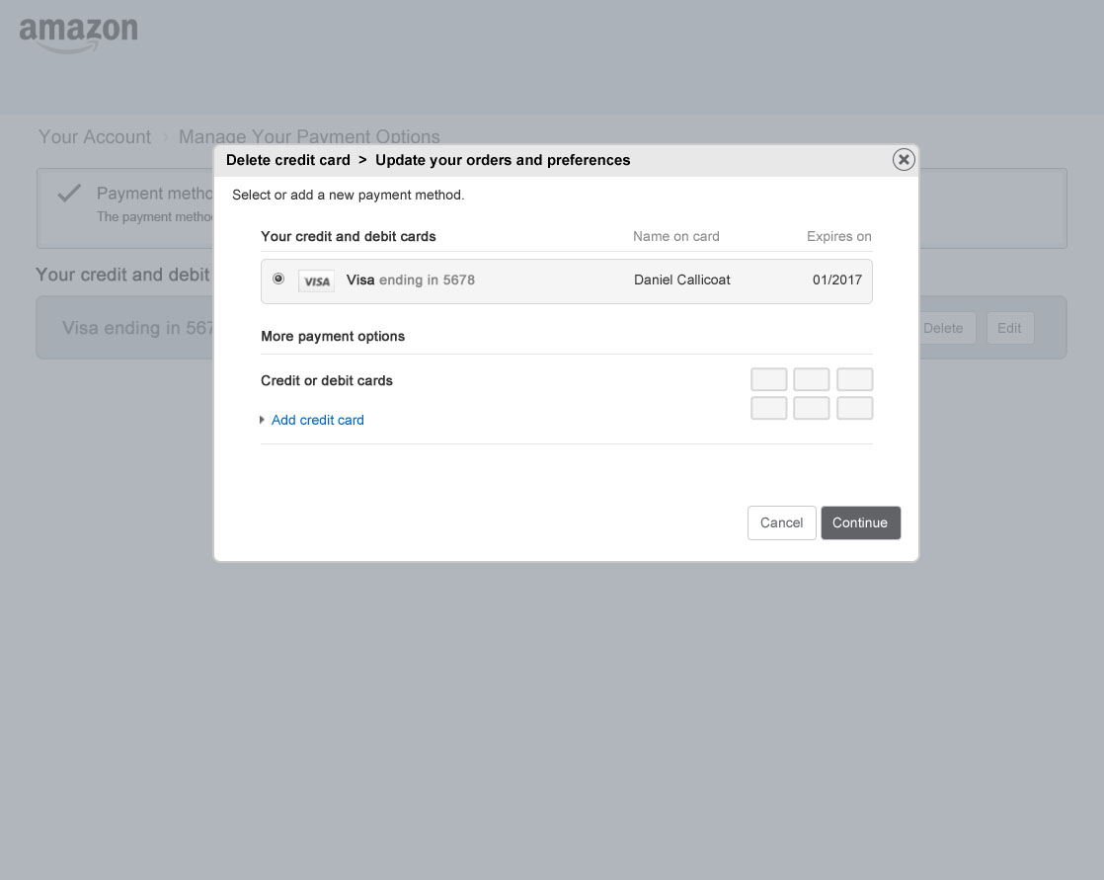
User selects new credit card.

Slide 10
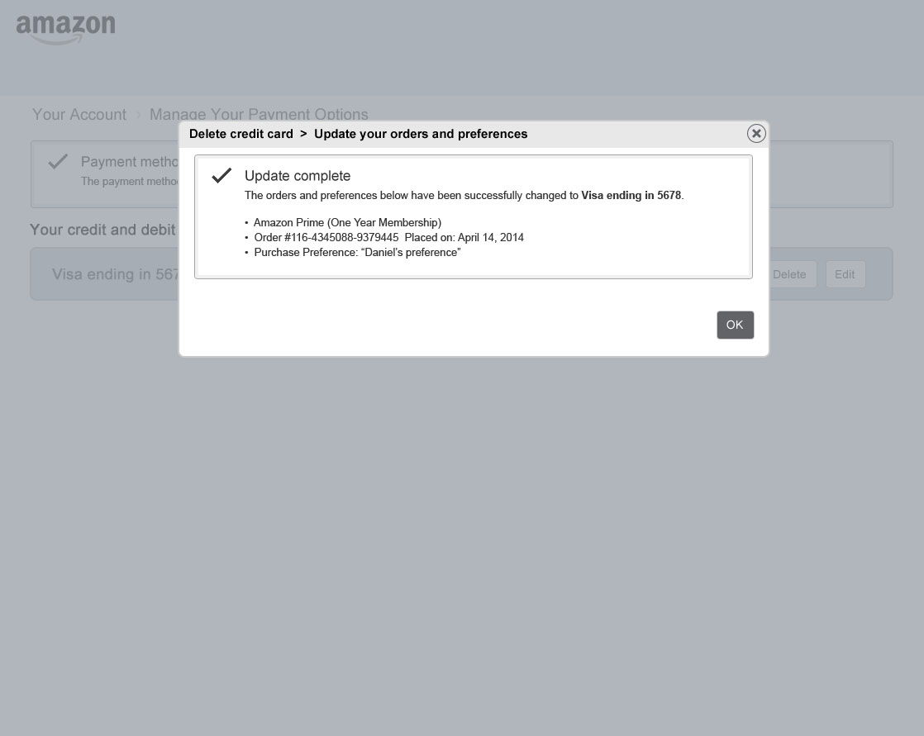
Success is shown for the changed items.

Slide 11
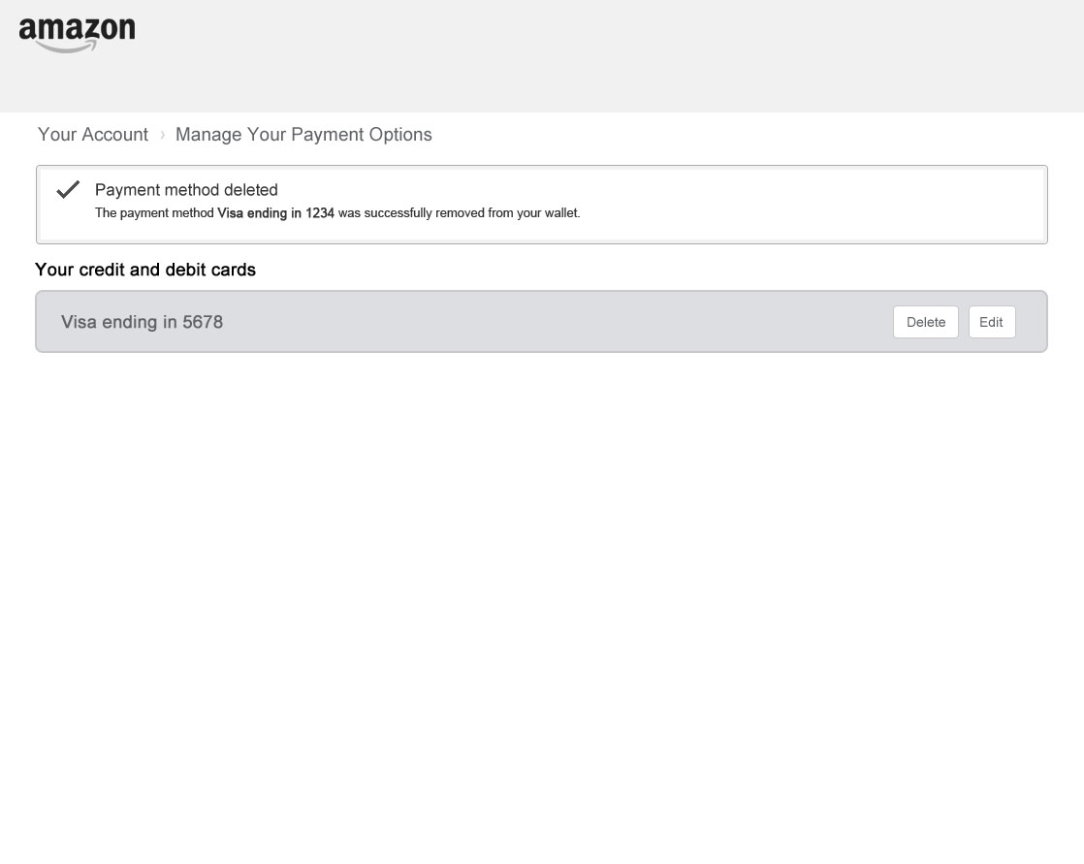
Success is shown for the deleted credit card.

Slide 12

I lost my credit card.
“When I deleted my lost credit card, Amazon told me all of the places that it was being used and allowed me to fix everything all at once.”

Slide 14
Section 2: Preference
Common customer problems:
  • “I want to save my choices and use them for all of my future purchases. But it’s not clear how I do that.”
  • “I want to see what choices will be used when I make a purchase. Without seeing what will be charged or where it will be shipped I am hesitant to use 1-click.”
  • “I want to easily select a different preference. Sometimes when I want to use a different preference I have to navigate to my account settings and change my default preference to use it. Then later go back and change it back again.”

Slide 15
I want to save my choices
I want to save my choices.
“I primarily use a single credit card and my home shipping address. I want to save these settings once and use them again for my other purchases.”

Slide 16
“I want to save my choices.”
Why this is broken today:
Our current preference concept is limited in scope and extends poorly across businesses with conflicting eligibility.
How Payments Portal will fix this:
Create a shared purchase preference service and allow a customer to save their purchase choices from any purchase and reuse those choices for any other purchase.
New customer experience:
1) Make a purchase on Amazon
2) Save and name your choices
3) Select this preference next time

Slide 17
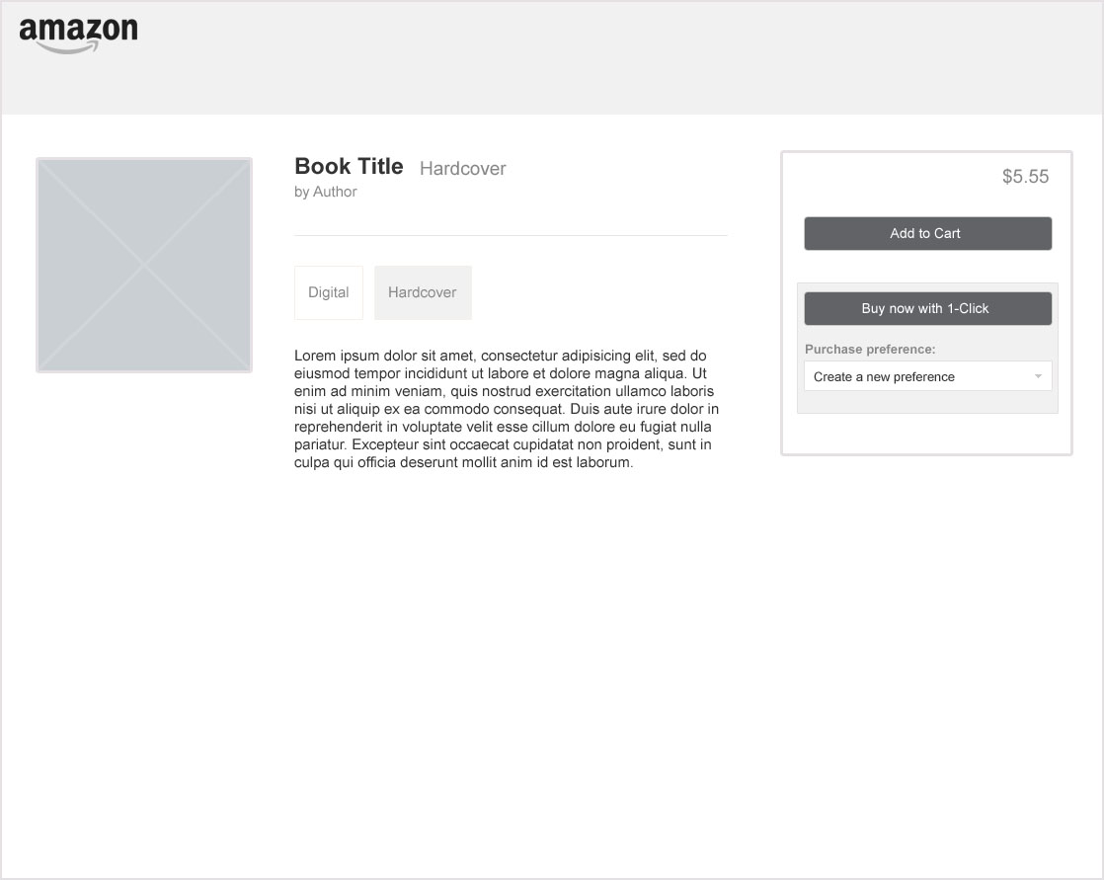
User adds the item they want to purchase to their cart.

Slide 18
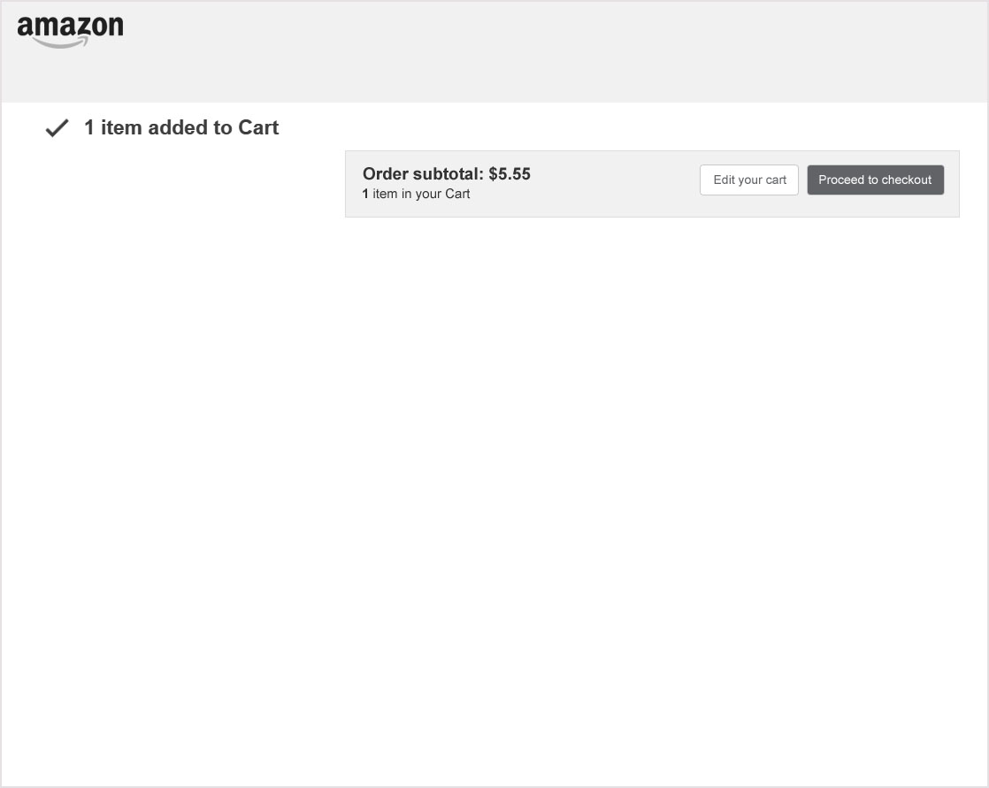
Success of cart addition. User initiates purchase by clicking “Proceed to checkout”.

Slide 19
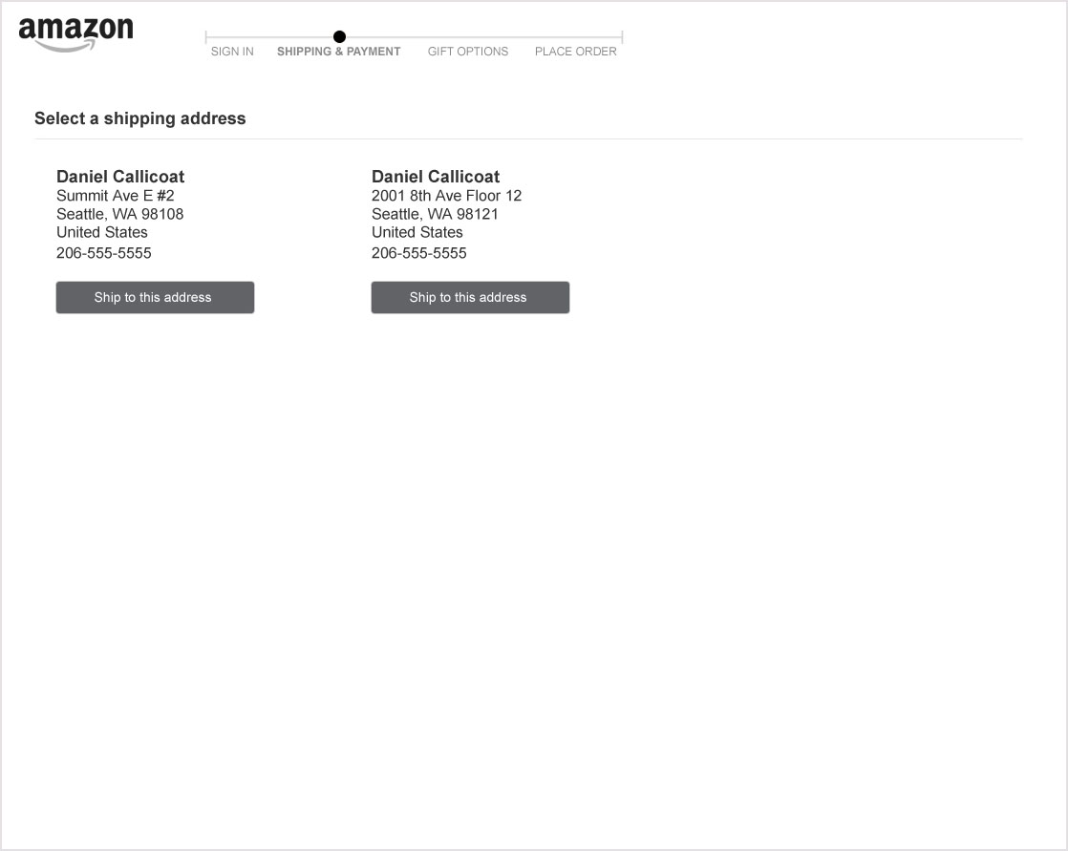
User selects a shipping address.

Slide 20
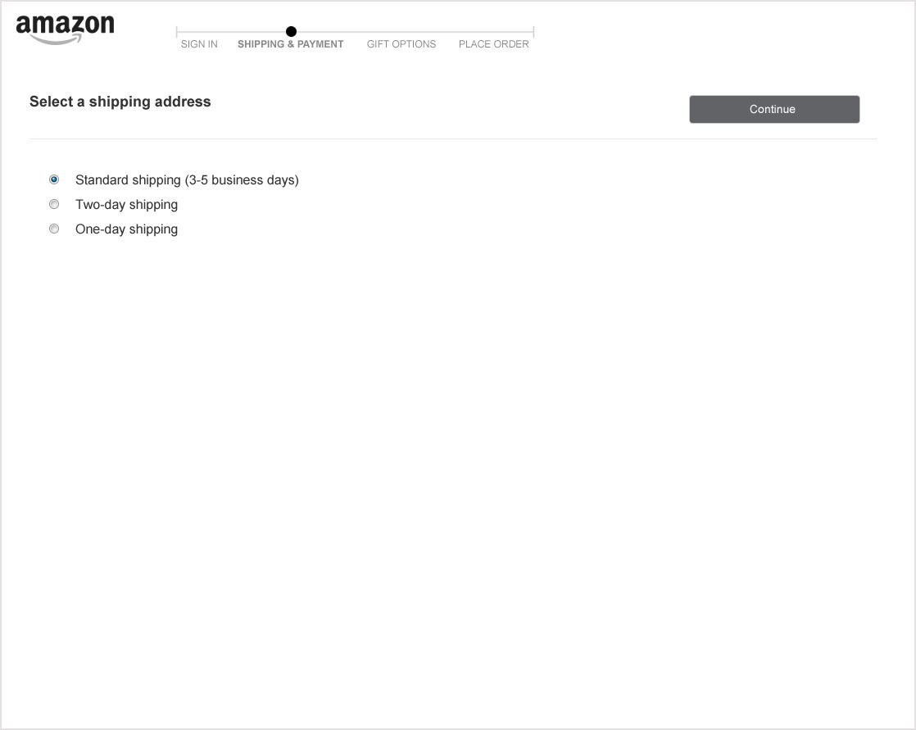
User selects a shipping speed.

Slide 21
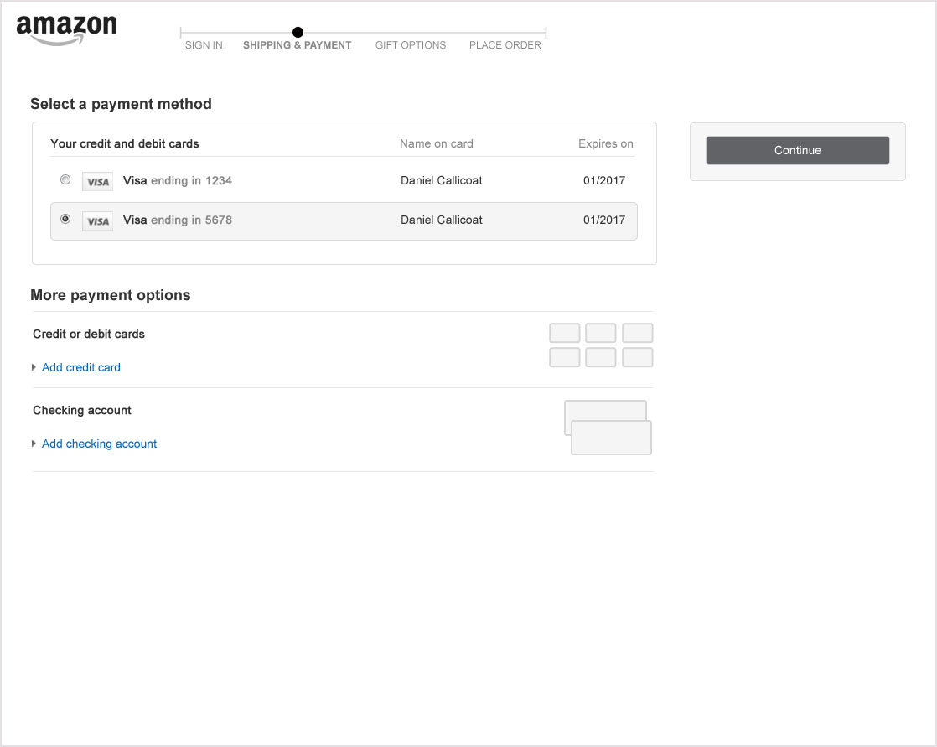
User selects a payment method.

Slide 22
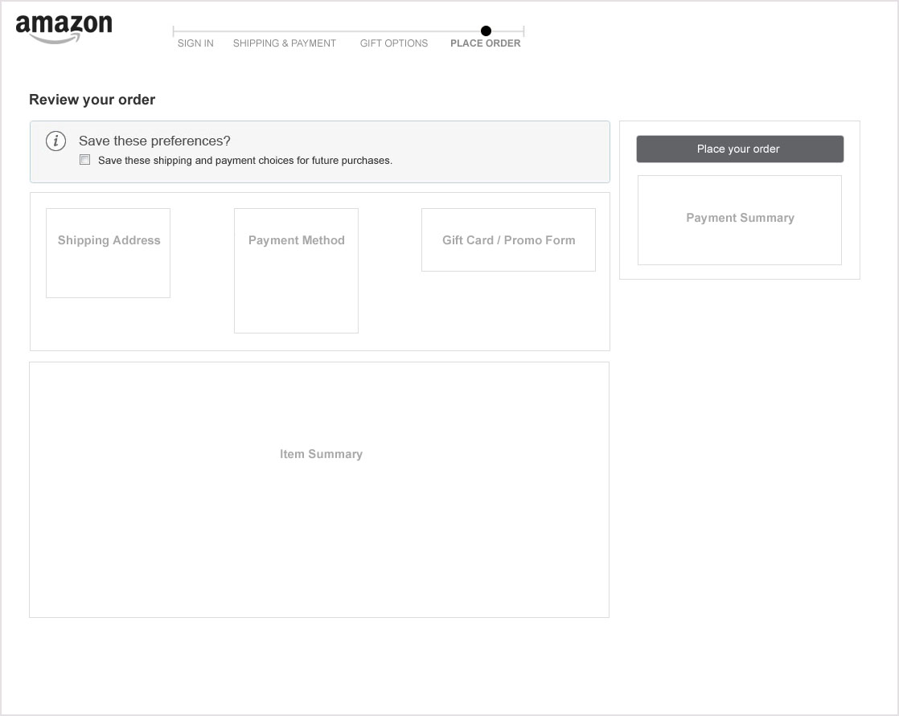
User decides they want to save these choices for future purchases. User checks the “Save these preferences?” option.

Slide 23
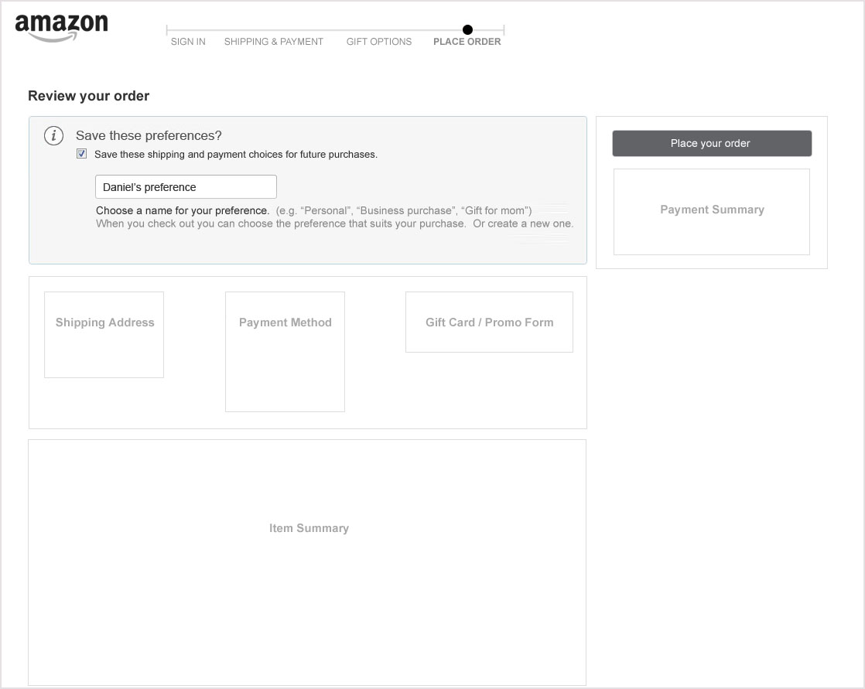
Preference name box is exposed prefilled with a suggested name. User may choose a different name if they wish. Then completes order.

Slide 24
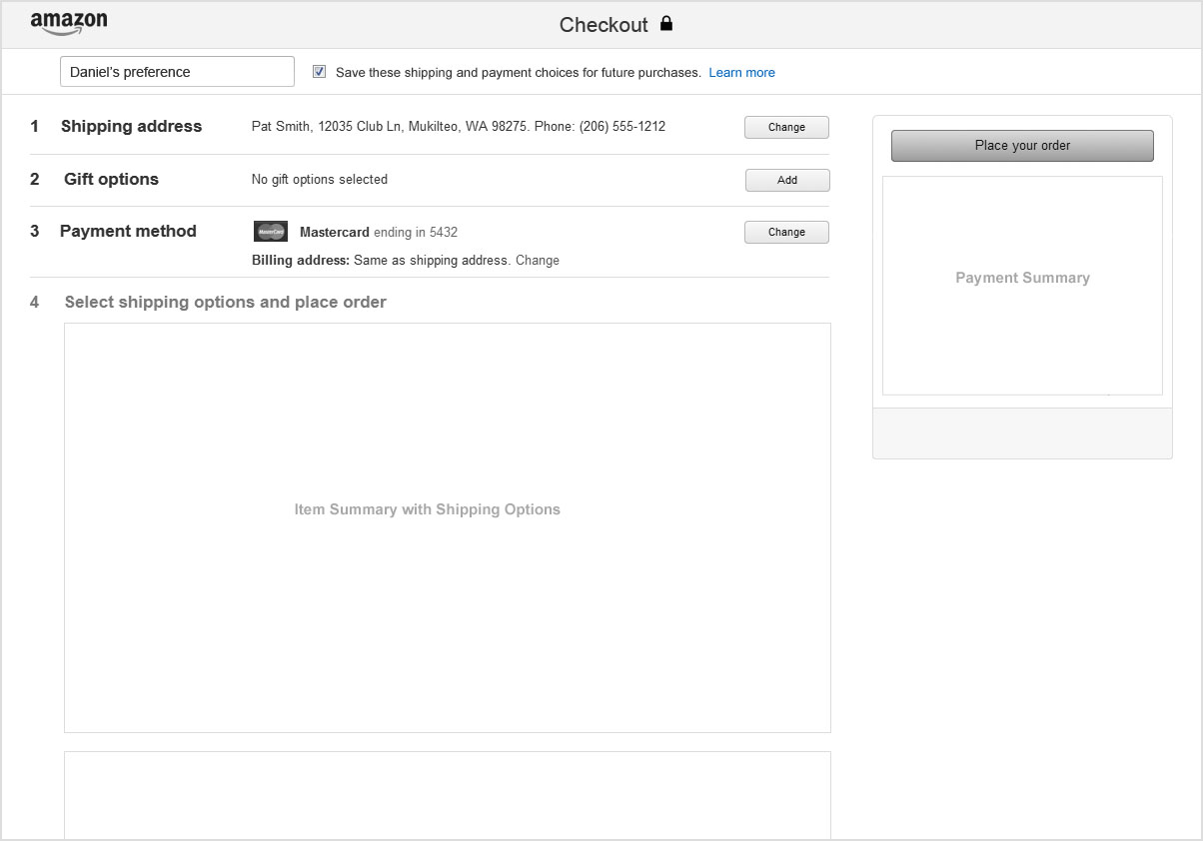
Alternate design for True SPC
New user is pre-opted with a naming option.

Slide 25
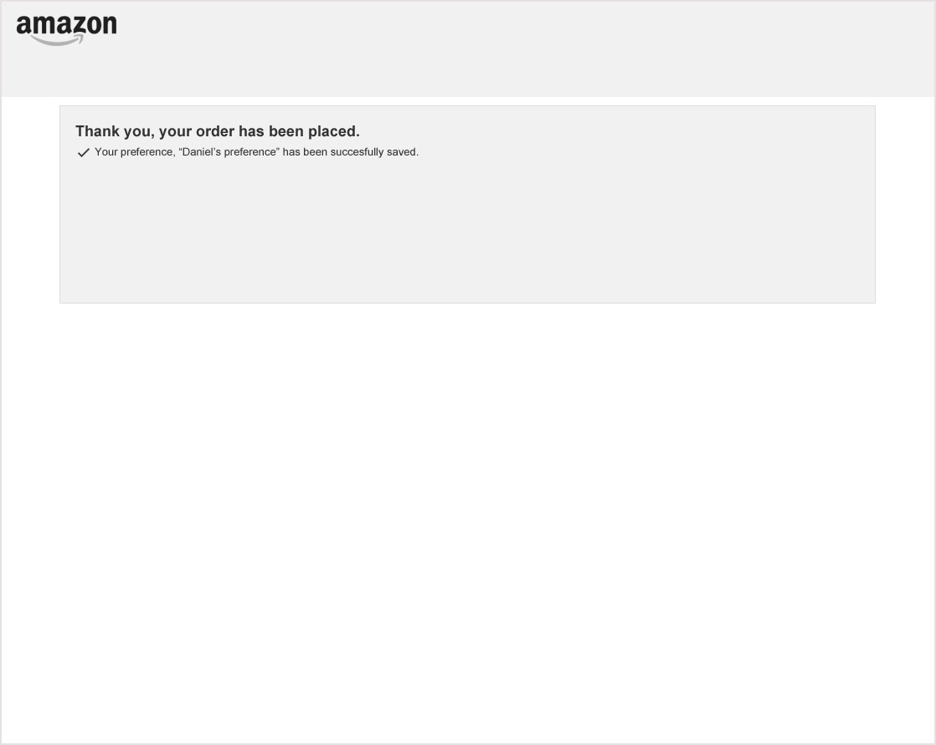
A confirmation of the saved preference is displayed on the order Thank You Page.

Slide 26
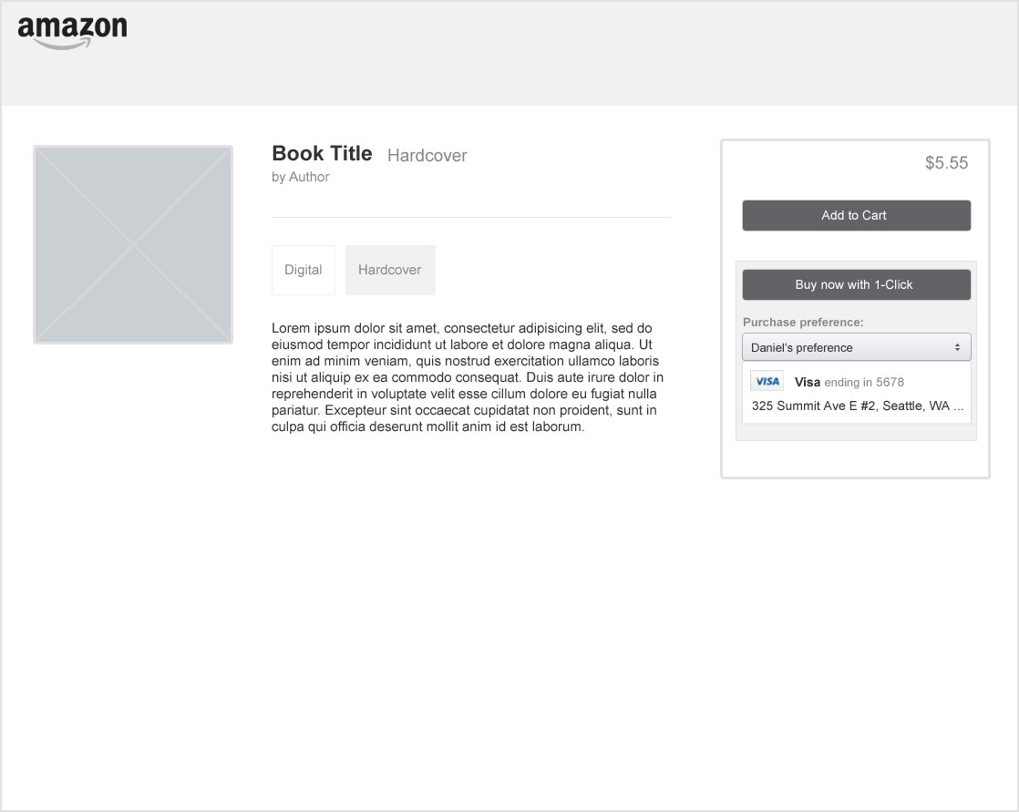
Example of subsequent details page.
For future purchases, this saved preference is clearly displayed and available to use.

Slide 27
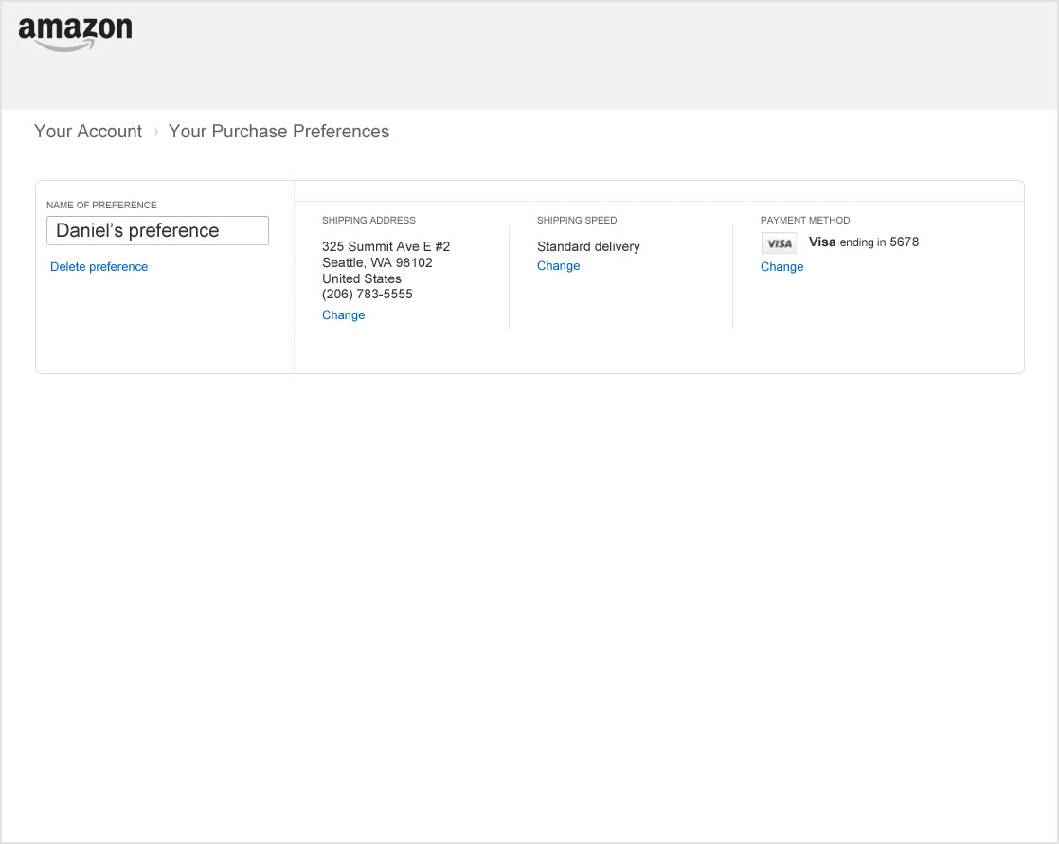
Example of the same preference on a Purchase Preference page.

Slide 28
I want to save my choices.
“It was easy to save my purchase choices. This will save me a lot of time and effort in the future.”

Slide 29
I want to see what will be used
I want to see what
will be used.
“I wish there was an easier way to see what payment method or shipping address is being used when using 1-click. I would feel more confident about committing to a purchase.”

Slide 30
“I want to see what will be used.”
Why this is broken today:
Currently customers can’t see what will be charged or where the item will be shipped when using 1-click. This lack of visibility creates purchase insecurity and inhibits adoption of convenience preferences.
How Payments Portal will fix this:
Provide a display of what choices will be used before committing to a purchase. (Note: This could also be done using the current technology.)
New customer experience:
1) View choices in preference display
2) Make purchase with confidence

Slide 31
The contents of a chosen preference are clearly displayed beneath the preference selection dropdown.

Slide 32
I want to see what
will be used.
“I can easily see what payment method or shipping address will be used for my 1-click purchases. Now I feel confident that the right card will be charged.”

Slide 33
I want to easily select a different preference
I want to easily select
a different preference.
“If I want to use my business card to buy a digital book, I have to change my default 1-click in my account settings. Why can’t I choose my preferences more easily?”

Slide 34
“I want to easily select a different preference.”
Why this is broken today:
Preference selection is inconsistent and only available for some businesses. Relying solely on a single default prohibits the use of multiple preferences without an unnecessarily large effort.
How Payments Portal will fix this:
Provide a consistent interface to easily select a saved preference.
New customer experience:
1) Choose preference in dropdown
2) Make purchase

Slide 35
Before a purchase is made, the user can clearly see what preference will be used. To see other preferences, the user clicks the “Purchase preference” dropdown.

Slide 36

All of the user’s saved preferences are shown. The user can also create a new preference. Here, the user chooses their “Business purchase” preference.

Slide 37

The new preference is now shown. The choices that will be used are clearly shown in the display window. The user clicks buy and their business card is charged.

Slide 38
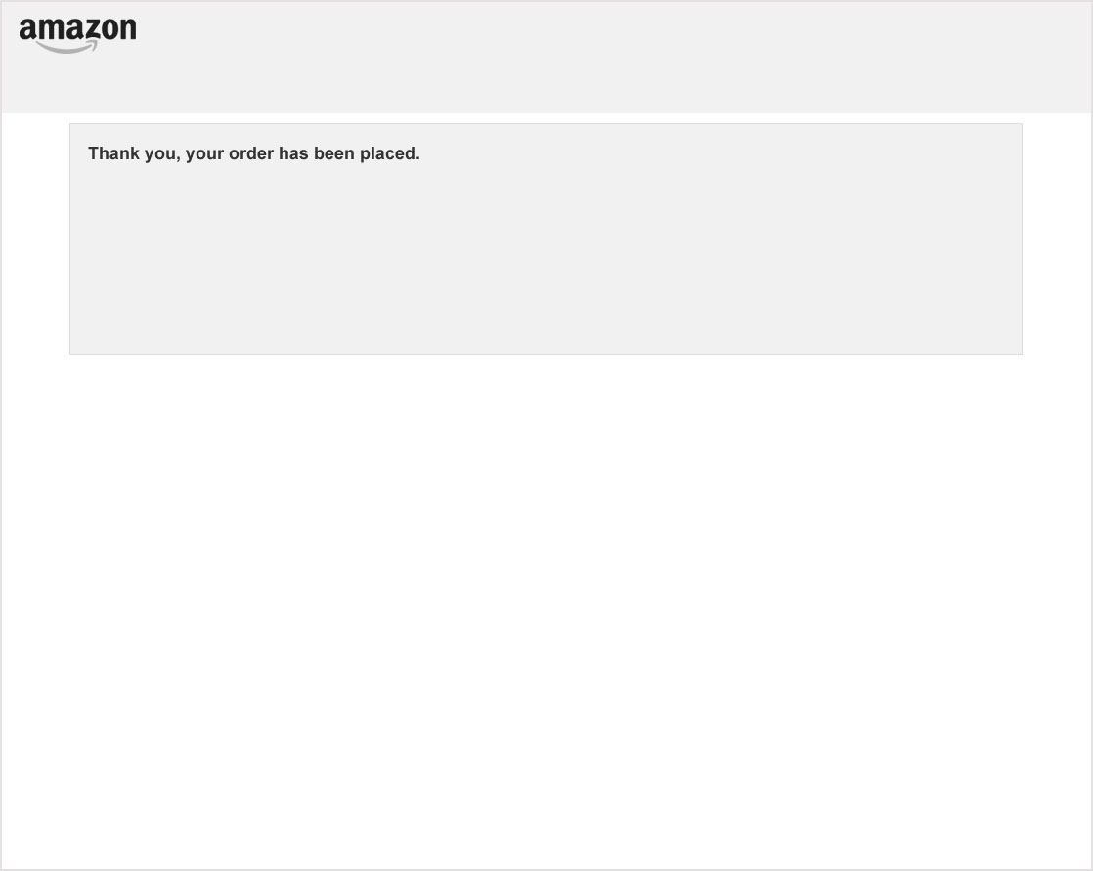
Order is completed. Thank you page is shown.

Slide 39
I want to easily select
a different preference.
“It was easy to select a different preference when I was checking out. Now, all of my preferences are available when I need them.”

Slide 40
appendix

Slide 41
Preference Display with address
Preference UI for Mobile:
Preference creation and selection for mobile browsers will need a variation. Here is an example of preference selection using Amazon’s mobile design patterns.

Slide 42
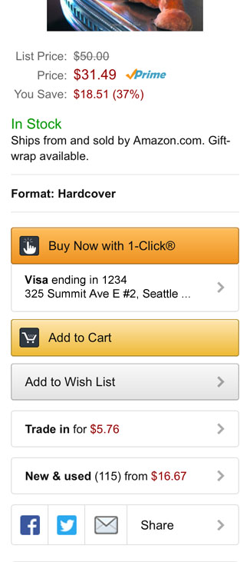
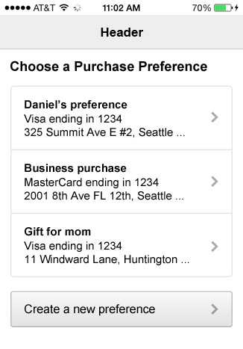
Example of preference display and selection for Amazon.com in a mobile browser.

Slide 43
Preference Display with address
Update UI for Mobile:
Mobile browsers could support the full range of update features. Both for editing an instrument or updating a preference where available.
Kindle devices may not include update. Payment management is deferred to the full site and preference management is limited.

Slide 44
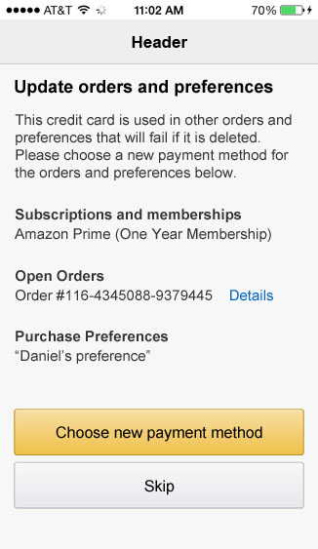
When a customer deletes an instrument from a mobile device we can still show them what associations will break and allow them to select a new payment method.

Slide 45
Preference Display with address
A consolidated Your Subscriptions page:
As an enhancement (optional), Portal could create a management page to consolidate subscriptions and recurring orders (orders where the customer is not present). Unlike Purchase Preferences, each preference is unique to the specific order and not shared. These preferences are not named and are referenced by the specific order or membership.

Slide 46
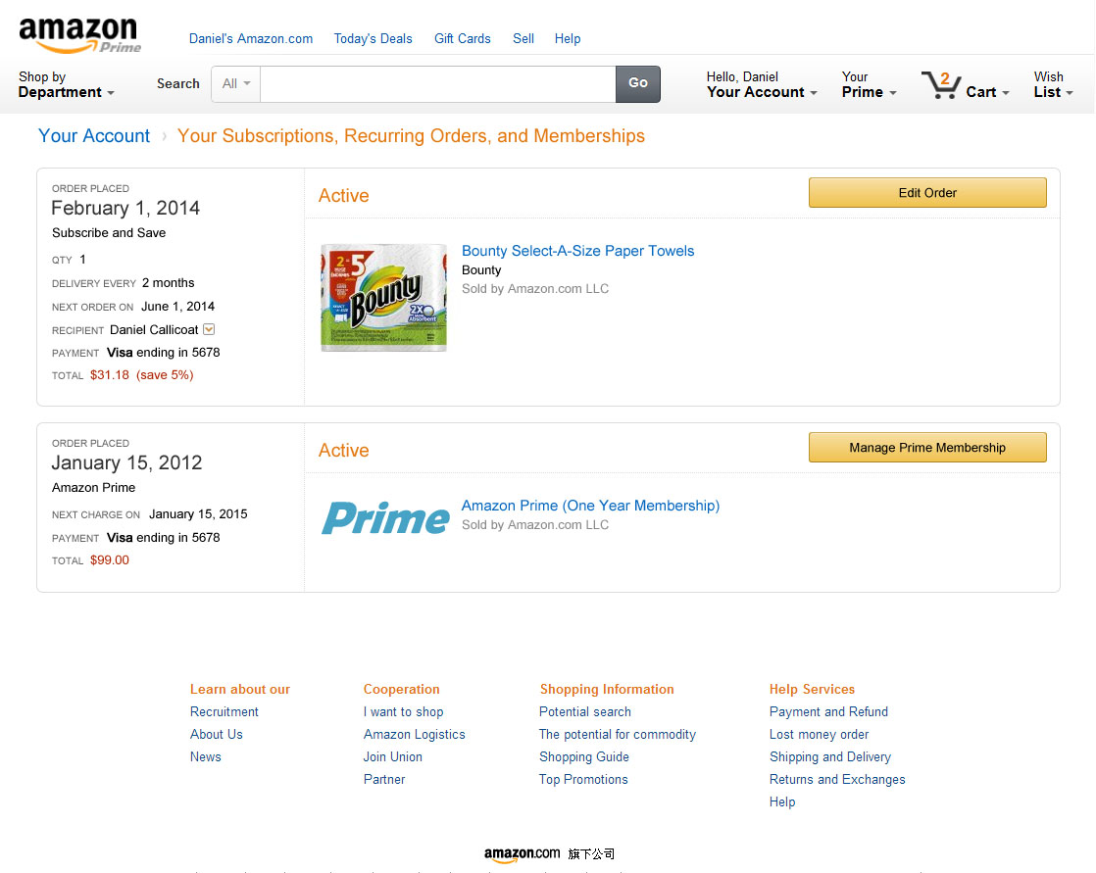
Example of a page consolidating preferences stored for subscriptions and memberships. Each order is unique. They are not named or shared like Purchase Preferences.

Slide 47
Preference Display with address
High fidelity preference display:
Full featured controls in a high fidelity example. In application many features compete in this space. The controls must stand out but not crowd or overpower.

Slide 48
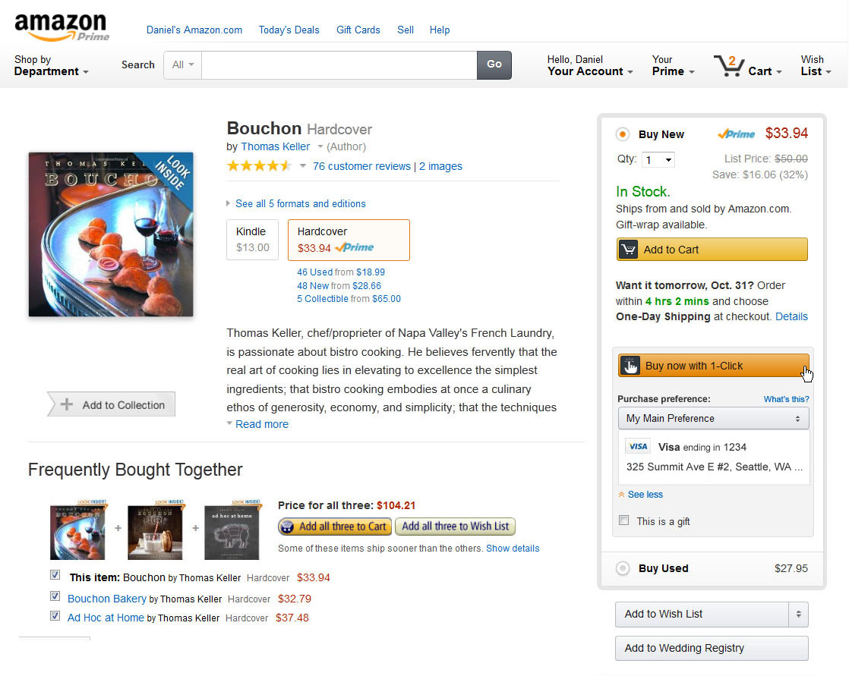
Full featured controls in a high fidelity example. In application many features compete in this space. The controls must stand out but not crowd or overpower.

Slide 49
Deferred update
Deferred Update:
A customer wants to wait to update their broken associations but wants to delete their card now.

Slide 50
User navigates to the Payment Options page and chooses to delete the chosen card.

Slide 51
The user then confirms the card deletion.

Slide 52
In this scenario, the user decides to defer updating the broken associations and clicks “Skip”.

Slide 53
Success is shown for the deleted credit card.

Slide 54
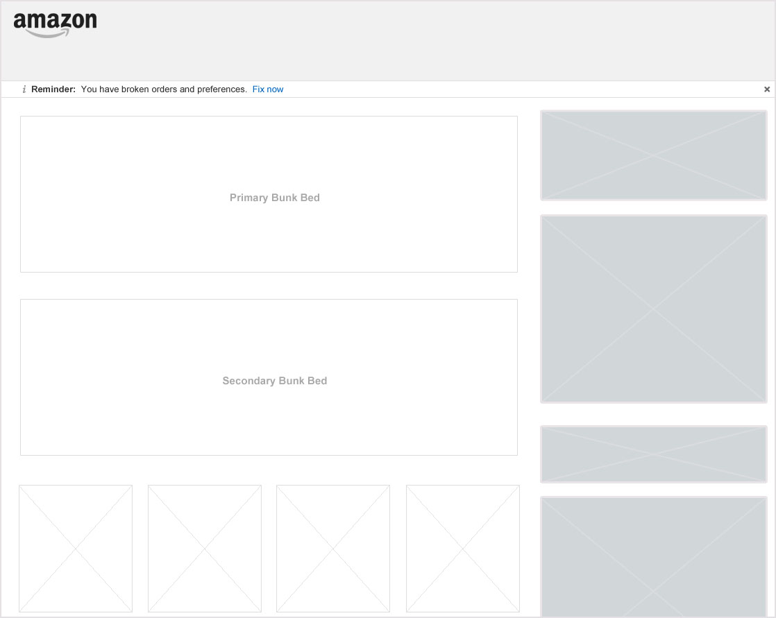
After, a notice is shown to the user in the header to remind them of the broken associations. Update can then be triggered from the reminder.

Slide 55
Eligibility conflict
Eligibility Conflicts:
A customer encounters an eligibility conflict for an order when selecting new payment method.

Slide 56
User navigates to the Payment Options page and chooses to delete the chosen card.

Slide 57
The user then confirms the card deletion.

Slide 58
Associations are shown. User opts to choose new payment method.

Slide 59
User selects new credit card.

Slide 60
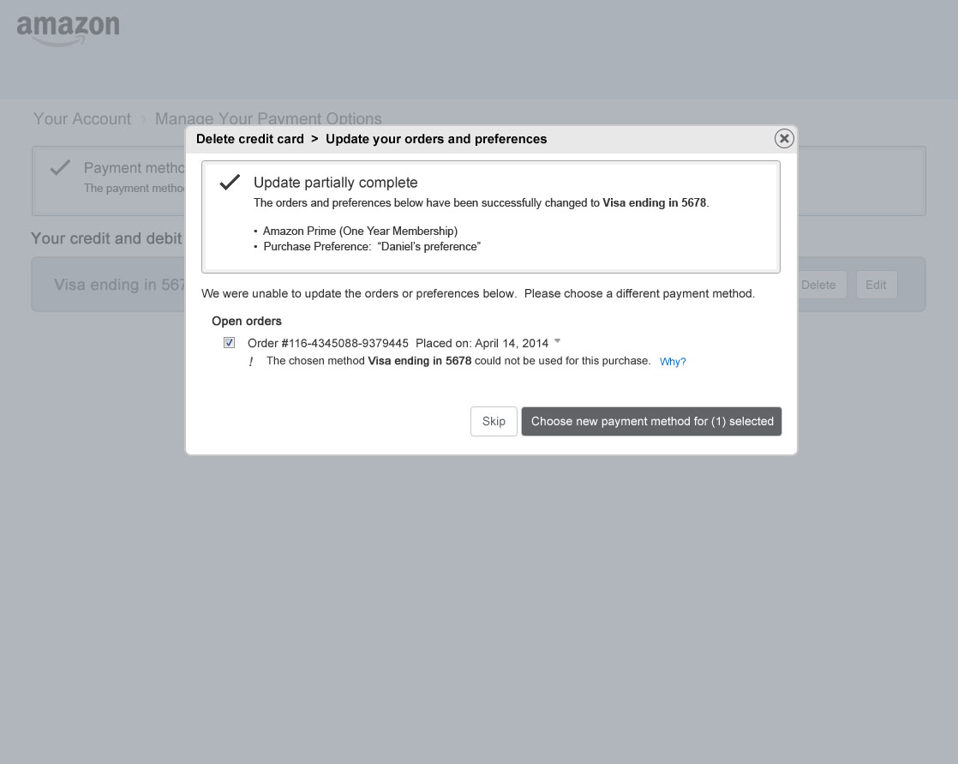
Successful updates are shown. If any items experience an eligibility conflict, the remaining items are relisted with an inline error message and help link. The experience then iterates allowing a new selection.

Slide 61
Eligibility conflict at the point of purchase
Eligibility Conflicts At Point Of Purchase:
A purchase preference is not usable for a given purchase. When a user views their preferences in the dropdown, the ineligible preference is unselectable with an explanatory link.

Slide 62
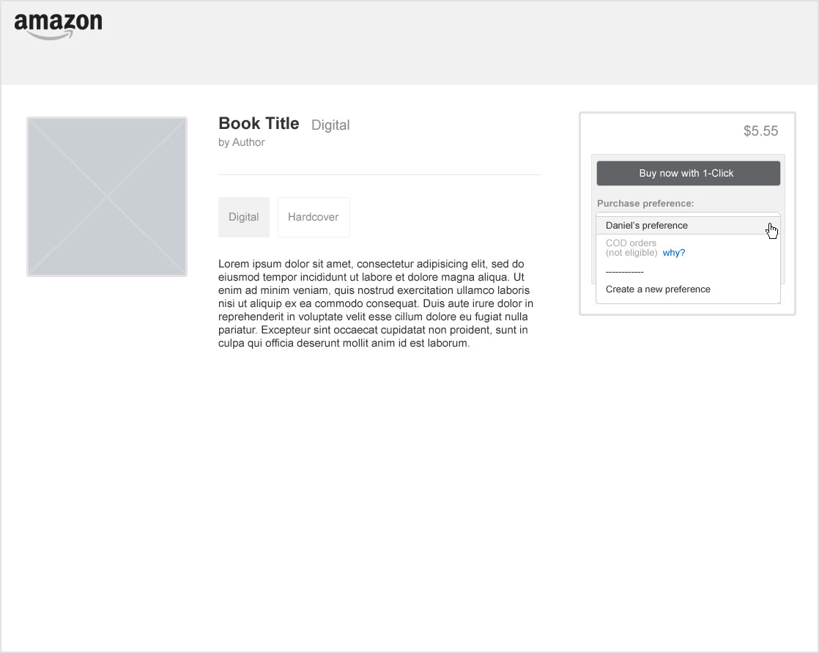
Ineligible preferences still appear in the list but are greyed out. A help link provides additional explanation.

Slide 63
I got a failure email
I got a failure email.
“I got an email saying one of my orders had failed because of a bad credit card. After I fixed the problem, I got an email saying another order had failed for the same reason. Why didn’t my change fix my other orders?

Slide 64
“I got a failure email.”
Why this is broken today:
When an order problem is updated, it is only fixed for that particular order. The customer must go to each other order to replicate the change. Then the user must update their subscriptions and settings across Amazon individually.
How Payments Portal will fix this:
When a customer updates an order, check to see if other orders and preferences are also affected and allow them to update everything at one time.
New customer experience:
1) Fix broken order
2) Apply that fix to other relevant areas

Slide 65
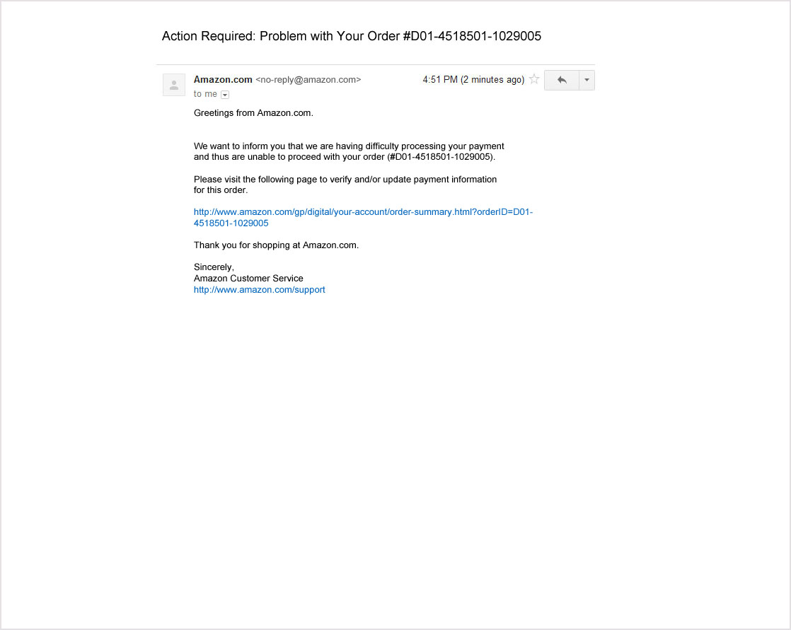
User receives an email saying an order has failed. They then click on the link provided.

Slide 66
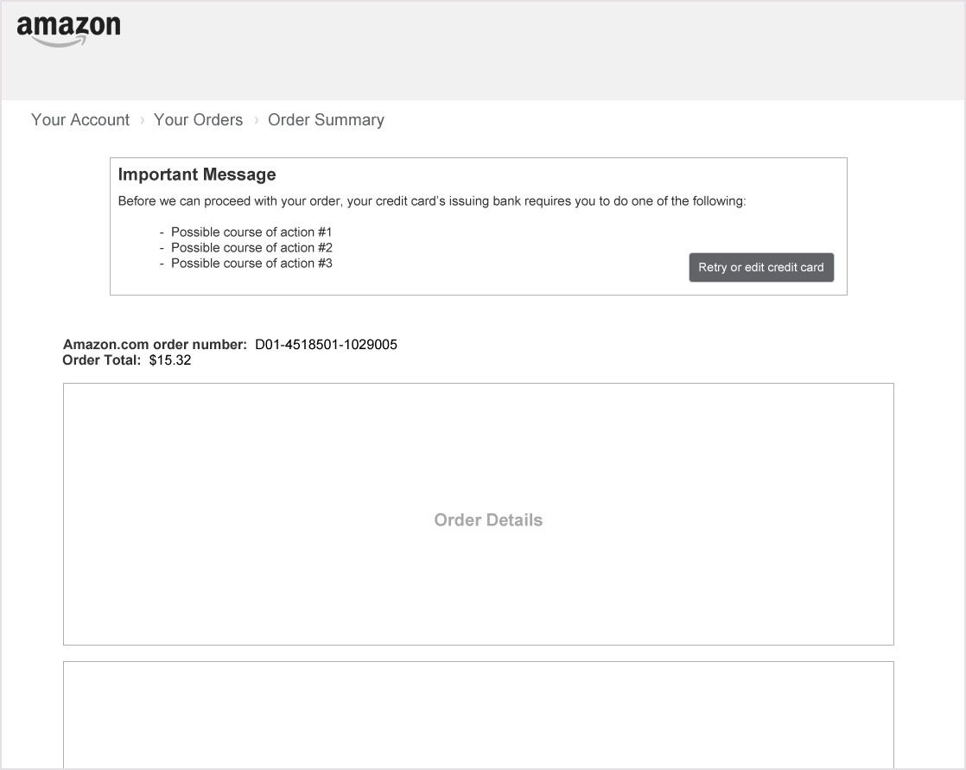
User is taken to the order’s details page. An error box allows the customer to update the order’s payment choices.

Slide 67
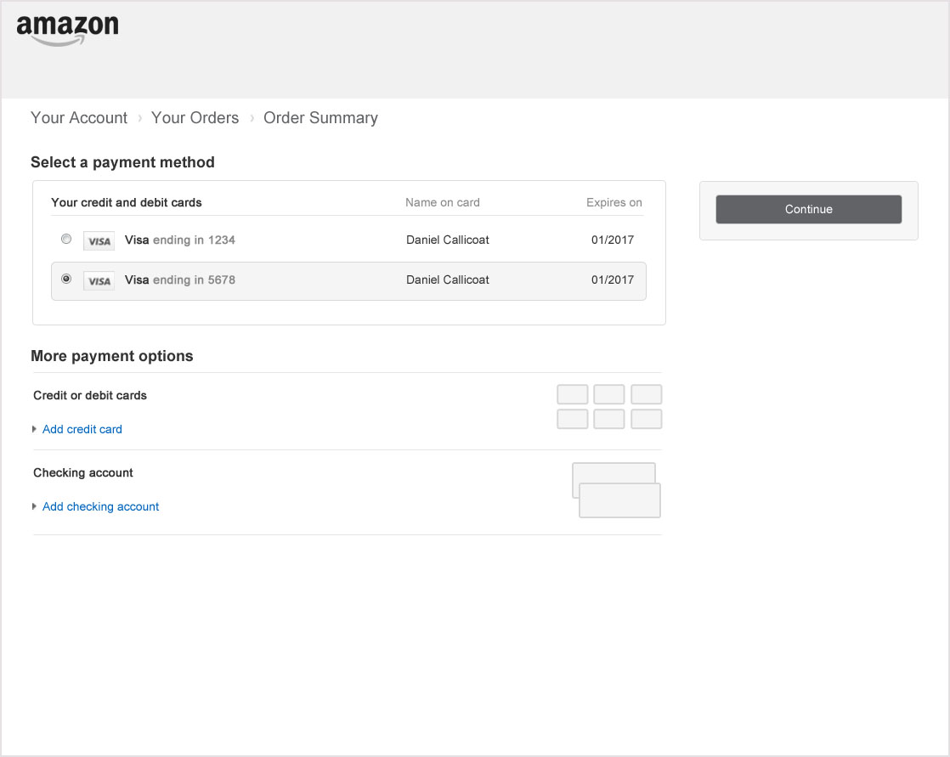
User chooses or adds an alternate credit card.

Slide 68
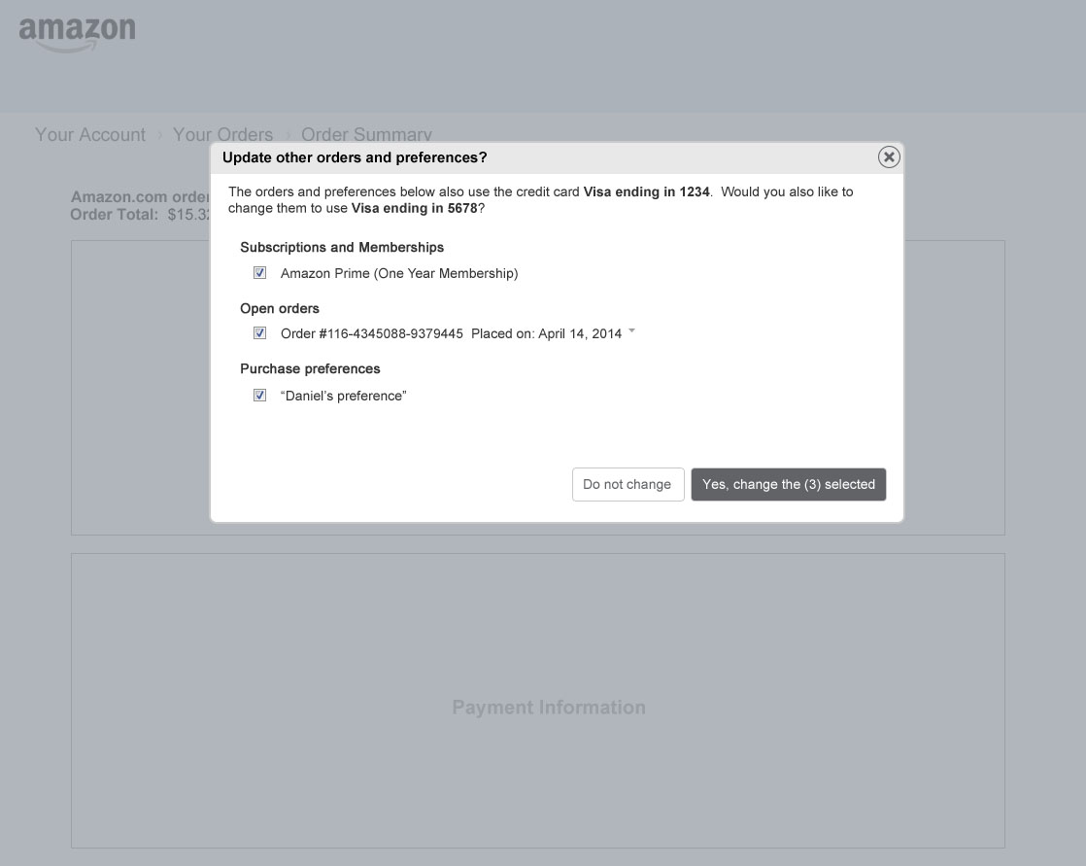
Associated items are detected and listed. The user is asked to confirm that they would like to make the same change. User may make a partial selection.

Slide 69
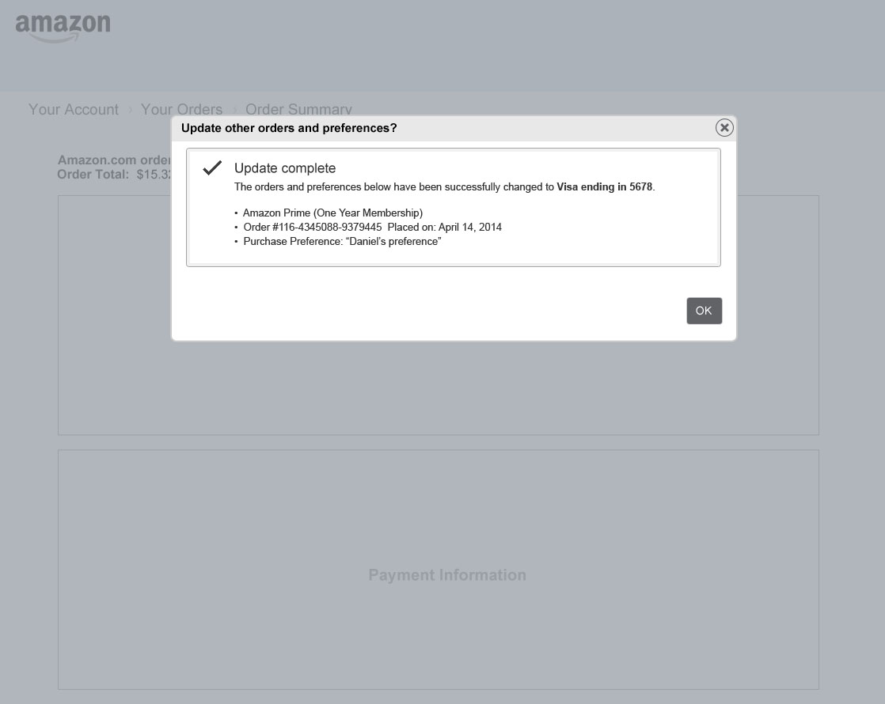
Success of change is shown in the popover. User clicks “OK” and closes the popover.

Slide 70
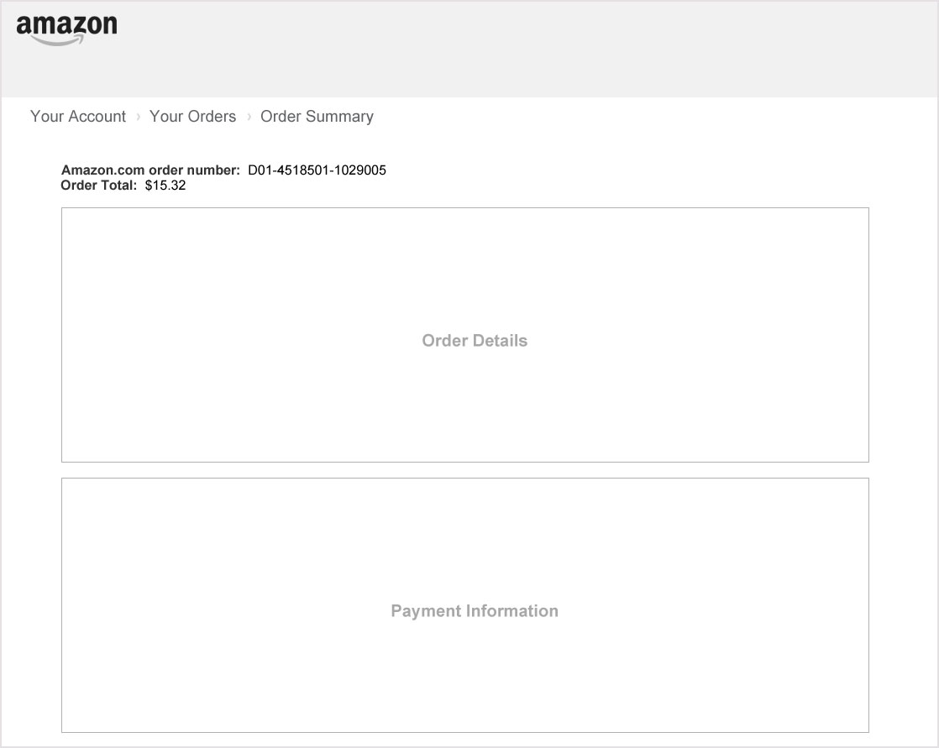
The updated order details page is shown.

Slide 71
I got a failure email.
“When I updated a failed order, Amazon told me the other places that might be a problem and allowed me to change my payment method for all of them at once.”

Slide 72
I want to change my primary card
I want to change my
primary card.
“I have a better rate for my new Visa and I want to use it as my primary card across Amazon. But to change it everywhere, I have to update each order and preference individually. I can’t even remember all of the places I’ve used my card.”

Slide 73
“I want to change my primary card.”
Why this is broken today:
Feature teams store their preferences locally. When a customer changes a preference in one place, there is no way to populate that change across other preferences.
How Payments Portal will fix this:
Create a shared preference service. When a customer changes one preference, allow them to make that change to any other preference using the same card.
New customer experience:
1) Change a preference anywhere
2) Populate that change anywhere else

Slide 74
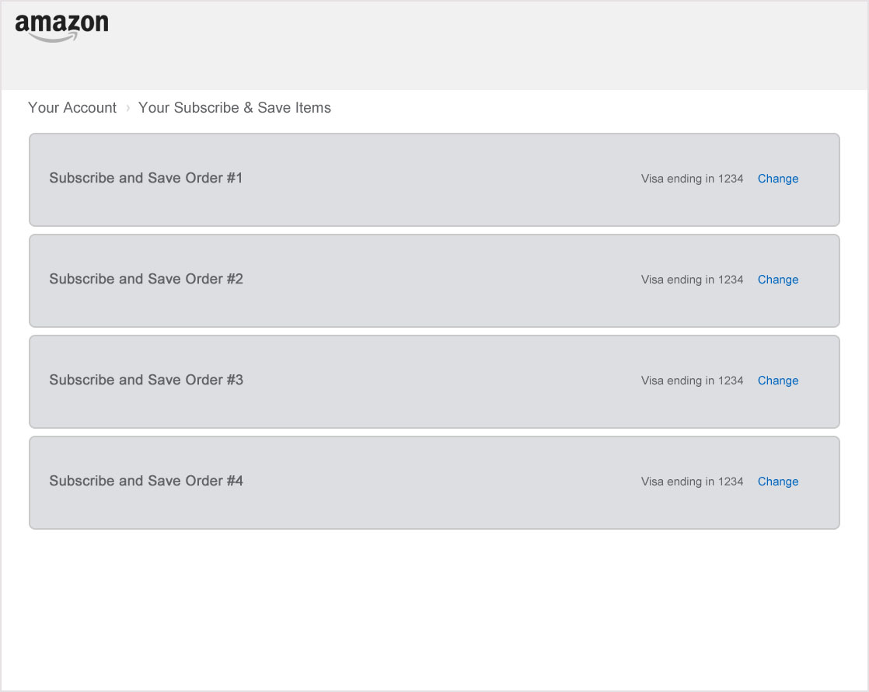
User initiates a change to any saved preference. Here, the user is changing the payment method for a Subscribe & Save order. Note other orders also use this card.

Slide 75
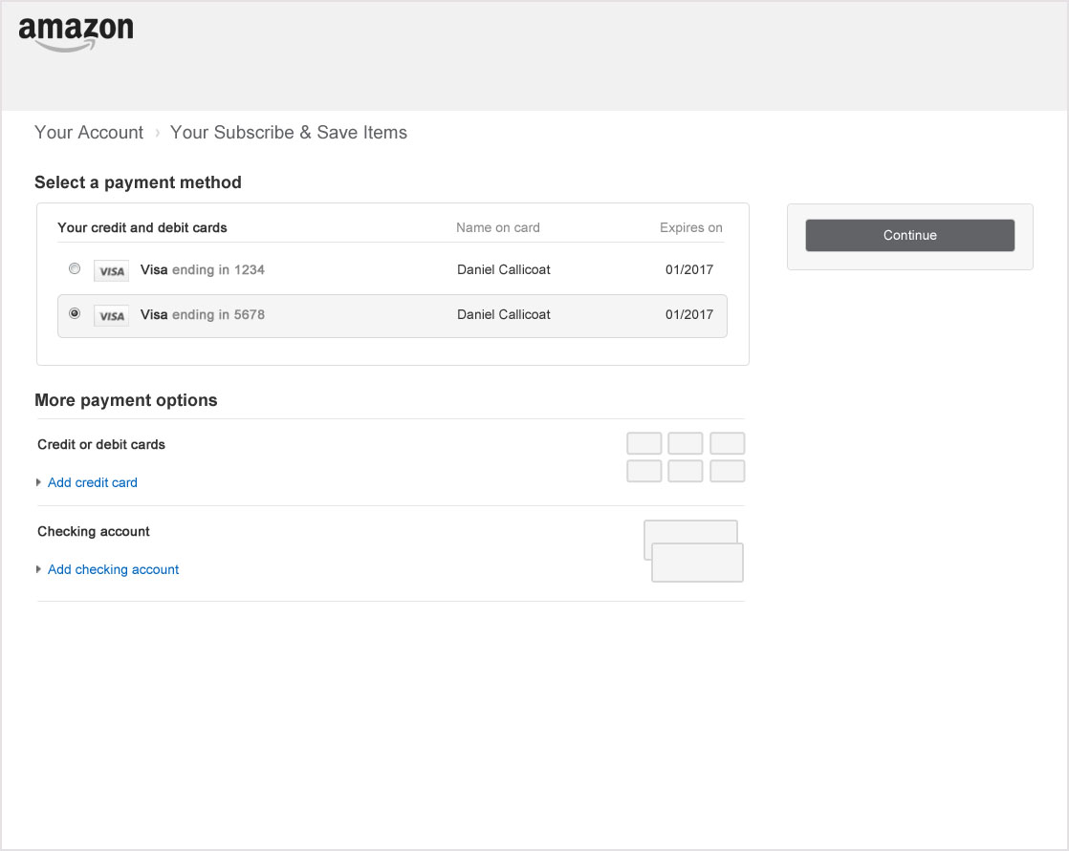
User selects or adds a new payment method.

Slide 76
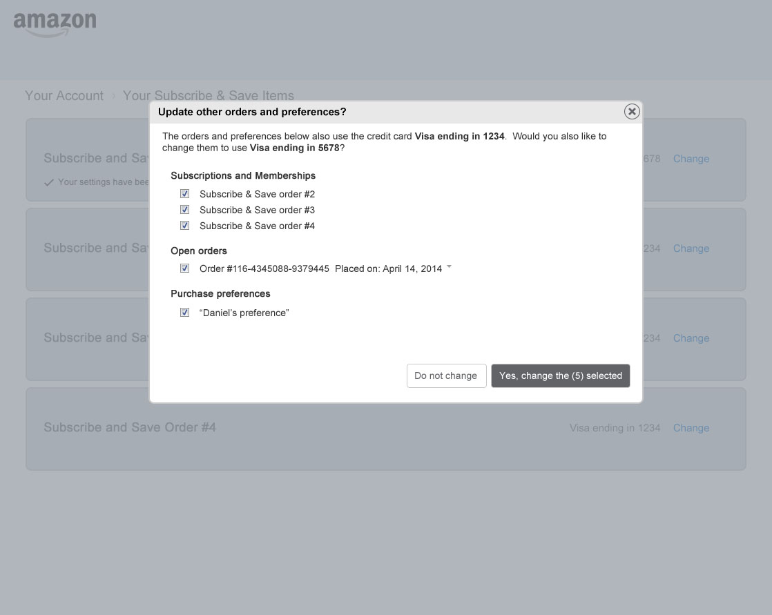
Associated items are detected and listed. The user is asked to confirm that they would like to make the same change. User may make a partial selection.

Slide 77
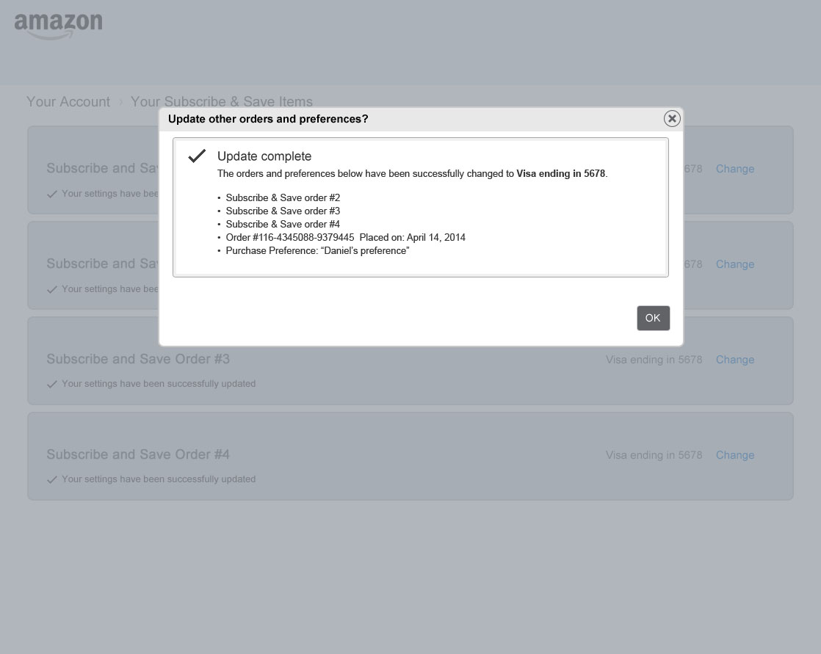
Success of change is shown in the popover. User clicks “OK” and closes the popover.

Slide 78
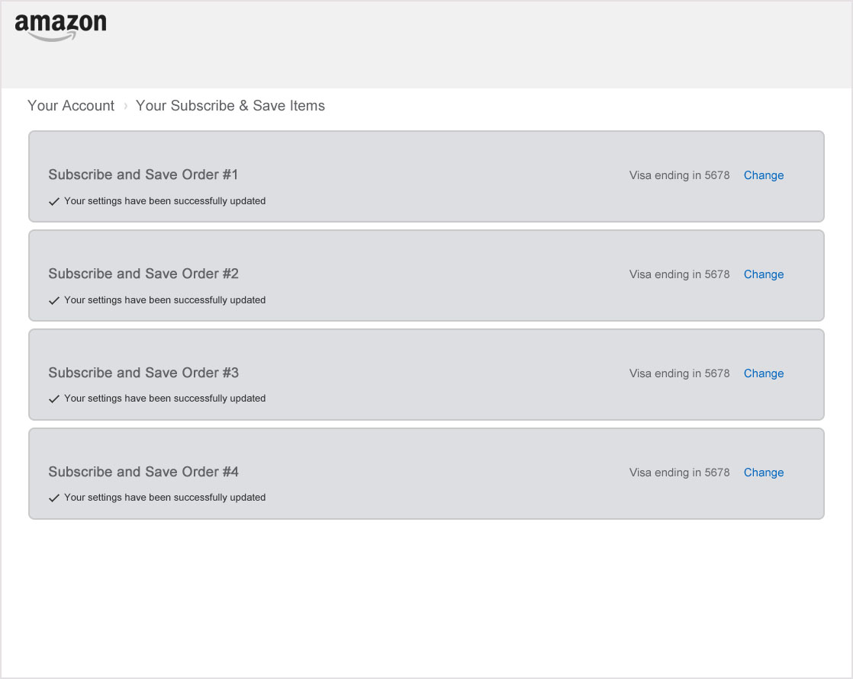
Success is shown for individual items on the page according to the user experience of the appertaining business.

Slide 79
I want to change my
primary card.
“I wanted to use my new Visa as my primary card. When I changed a preference on the site, Amazon detected all of the other places that I use the card and allowed me to change it everywhere. This would have been difficult and time consuming on my own.”

Slide 80
Eligibility conflict
Multi-tender Preference (implicit):
Limited multi-tender enabled for a preference. Here a user selects a credit card and points for that card along with their GC balance and their Amazon Money Account balance.
Shown is instrument selection, preference display, and preference selection at point of purchase.

Slide 81
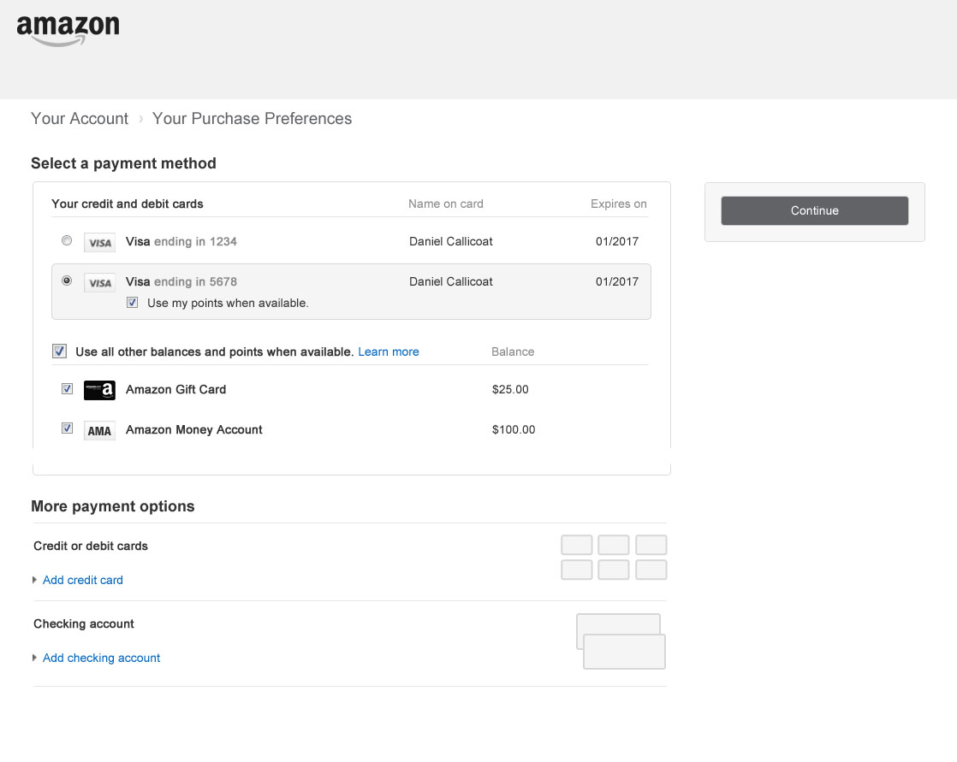
Implicit balance selection (i.e.- an umbrella opt-in) allows us to default all balances on. This includes all future accounts not yet created.

Slide 82
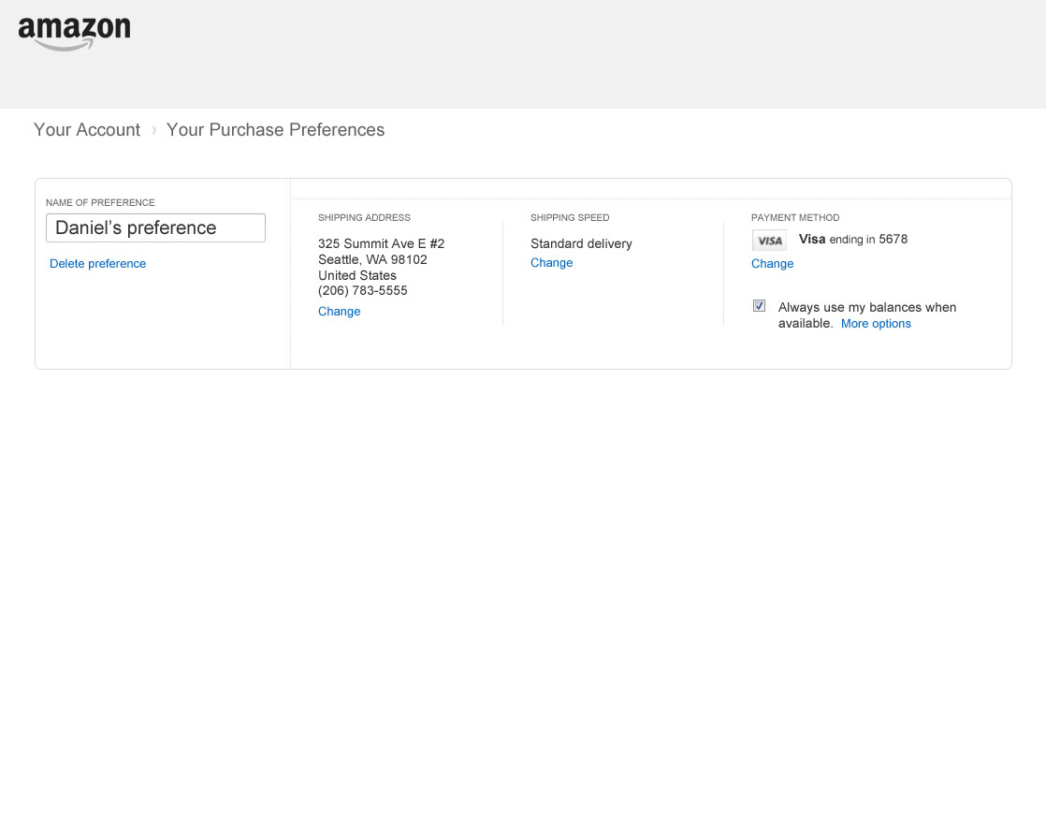
Implicit selection also creates a very compact and simple toggle for preference display. The “more options” link provides fine tuning for selection and precedence.

Slide 83
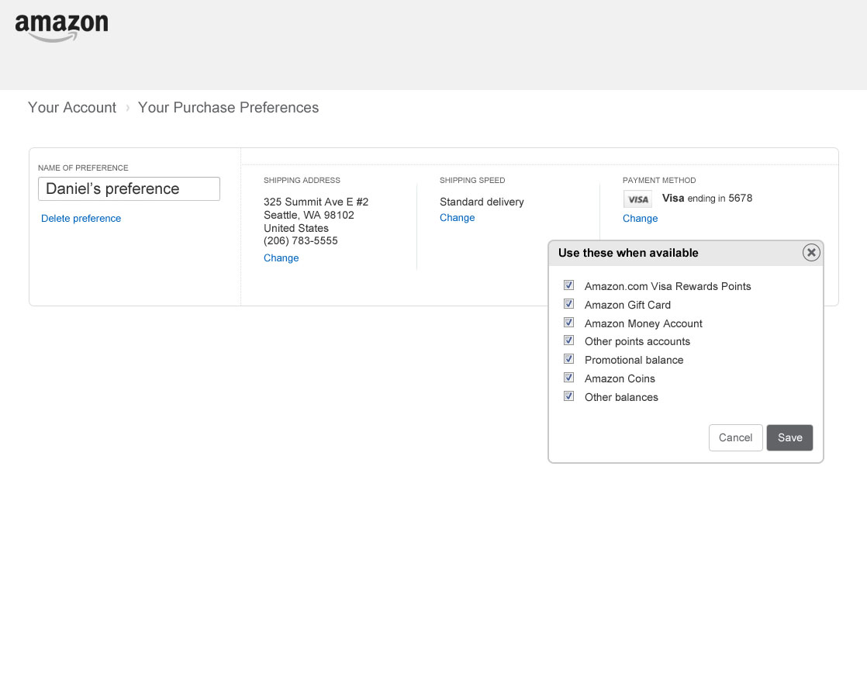
By clicking “More options” advanced users may specify exactly which balances should be used for each preference. Precedence could be added here if desired.

Slide 84

Implicit selection also allows users to quickly turn balances on and off during a purchase and simplifies the preference display.

Slide 85
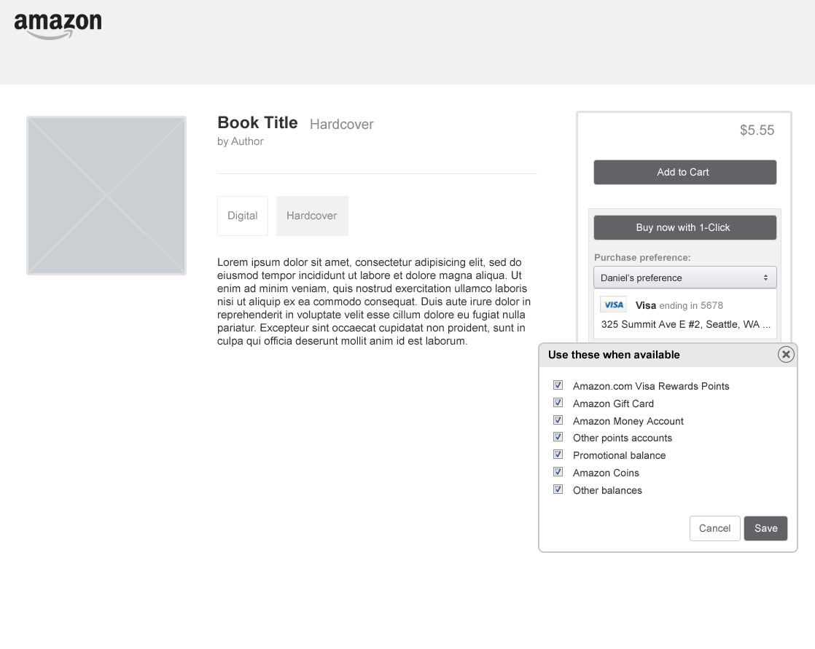
Advanced users may also choose exact consumption behaviour at the point of purchase.

Slide 86
Eligibility conflict
Multi-tender Preference (explicit):
Limited multi-tender enabled for a preference. Here a user selects a credit card and points balance for that card along with their GC balance and their Amazon Money Account balance.
Shown is instrument selection, preference display, and preference selection at point of purchase.

Slide 87
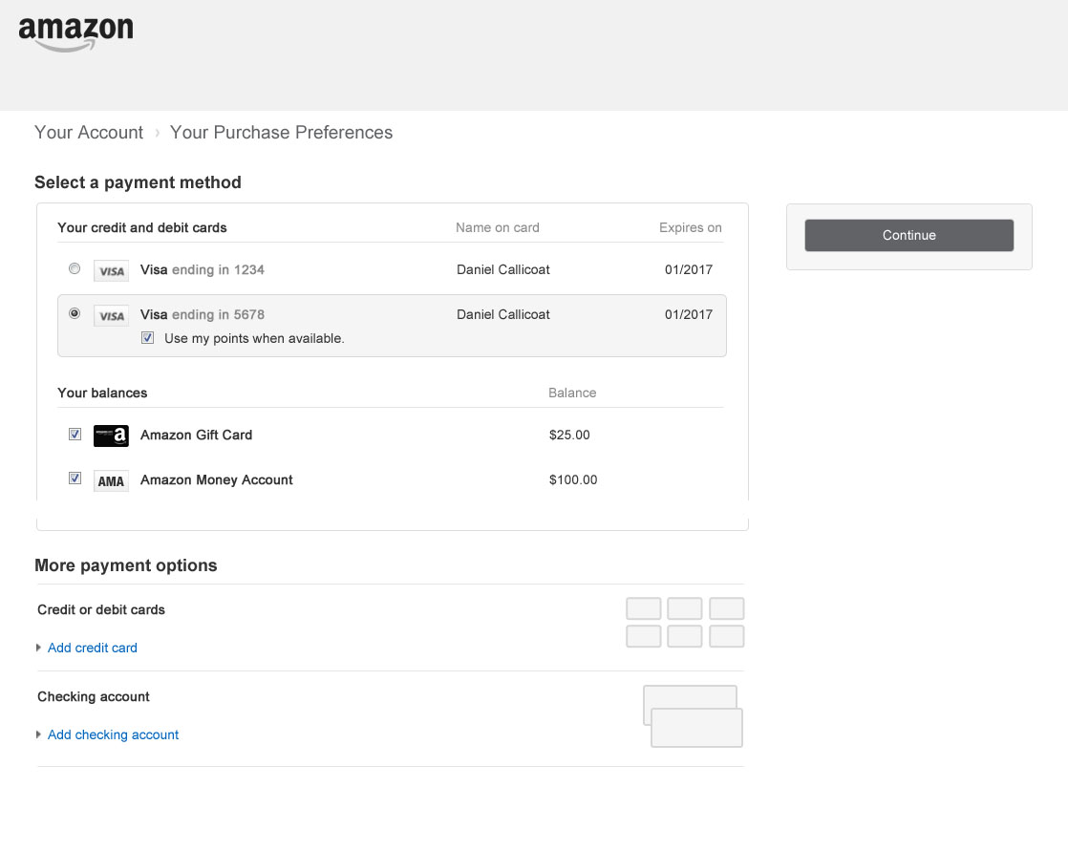
On the other hand, explicit selection (no umbrella) requires the user to manually select each account.

Slide 88
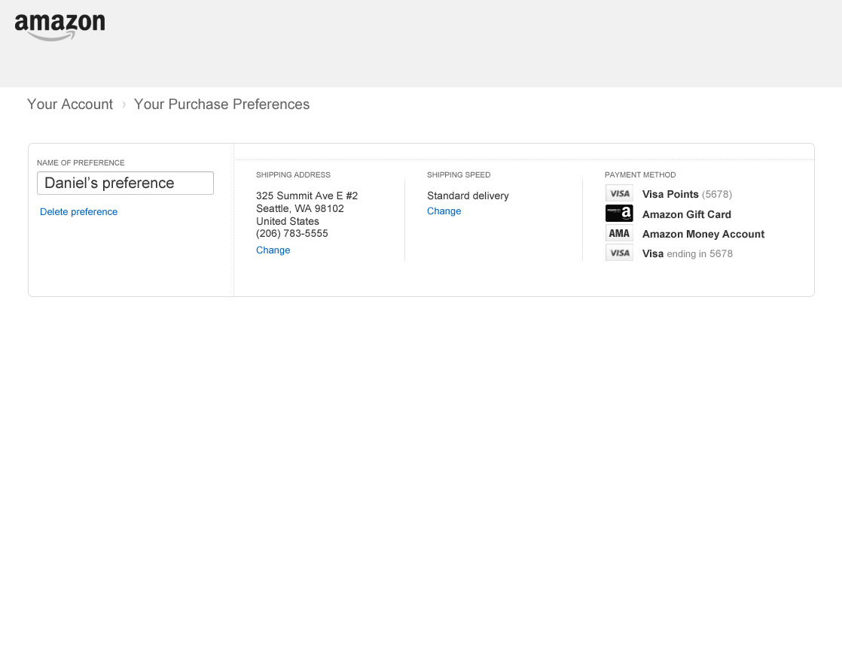
Explicit selection also requires that each instrument be displayed in the preference summary which can get quite long with multiple balance accounts.

Slide 89
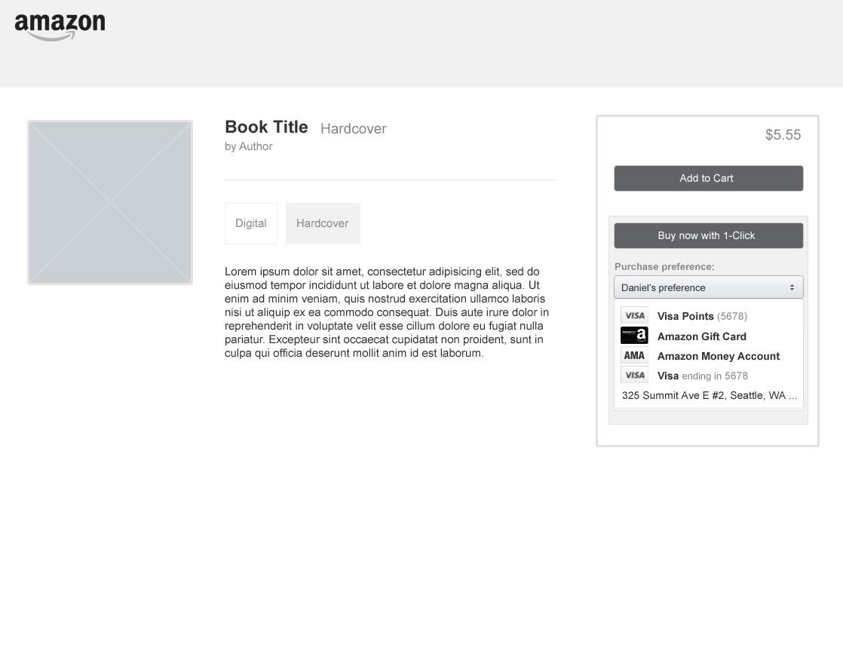
This also creates a more complex summary during purchase, makes it harder to change settings, and makes the shipping address less clear.

